Slide 1
Dhaka Tourist Spot and Market Place
Prepared By
Rakibul Islam
ID:151-15-5131
Sumaiya Sultana
ID:151-15-4949
Shaikat Saha
ID:151-15-4698

Slide 2
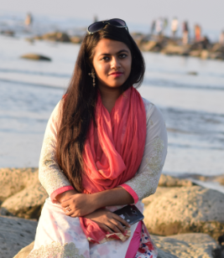
Sumaiya Sultana
ID:151-15-4949

Slide 3

Motivation
People sometime become confused about the off Day and Openings Hour of Tourist spot & Market Places.
Sometime they visit the Tourist spot & Market Place at Off Day & they become disappointed.
People Seeking help from other people for the Location, Off day , Opening Hour , Phone
Number of Tourist spot & Market Places. .

Slide 4
Features
Help people to Travel the famous tourist spot inside Dhaka
Provide people the helpful information about market place.
Tourist Spot : Location, Off day , Opening Hour , Phone
Number & Details Description.
Market Place : Location, Off day , Opening Hour , Phone
Number.

Slide 5
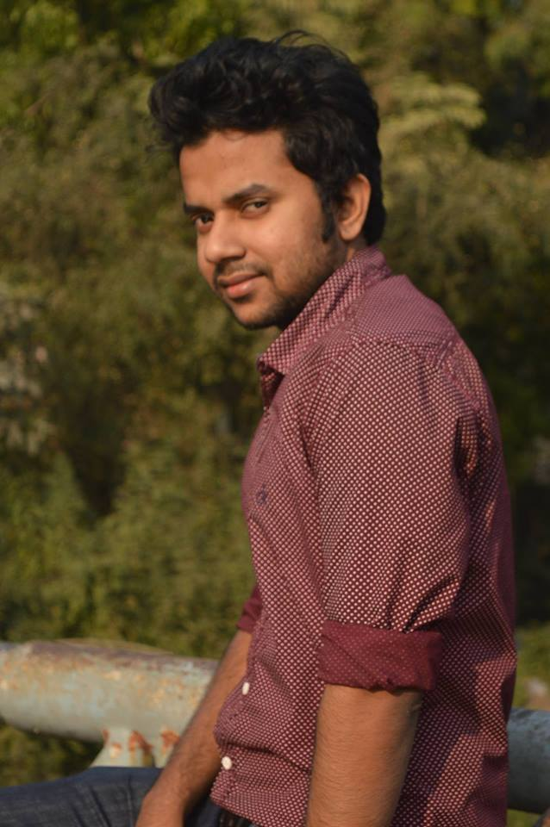
Rakibul Islam
ID:151-15-5131

Slide 6
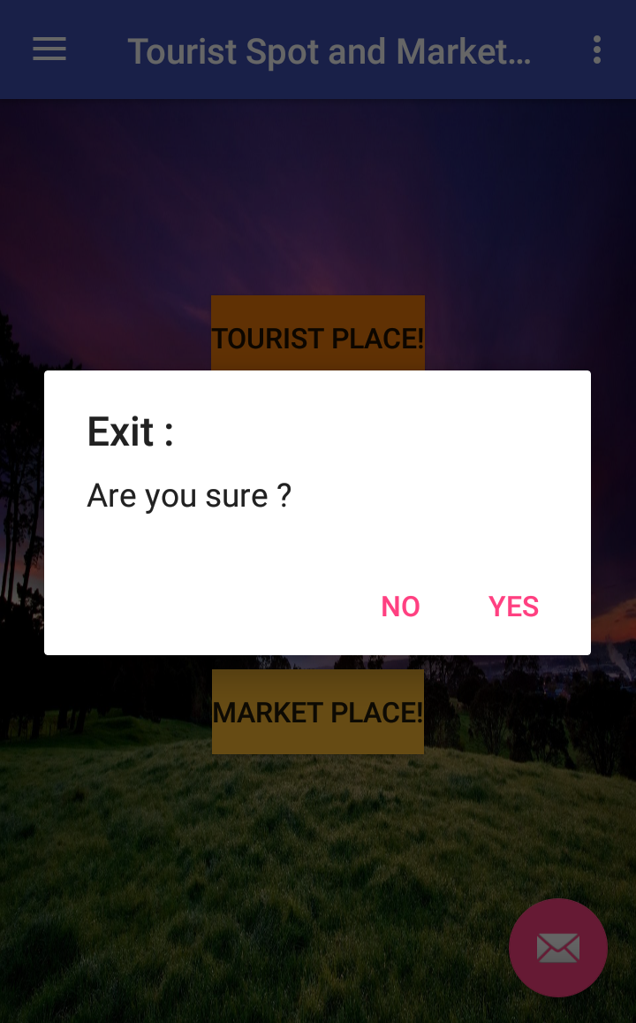
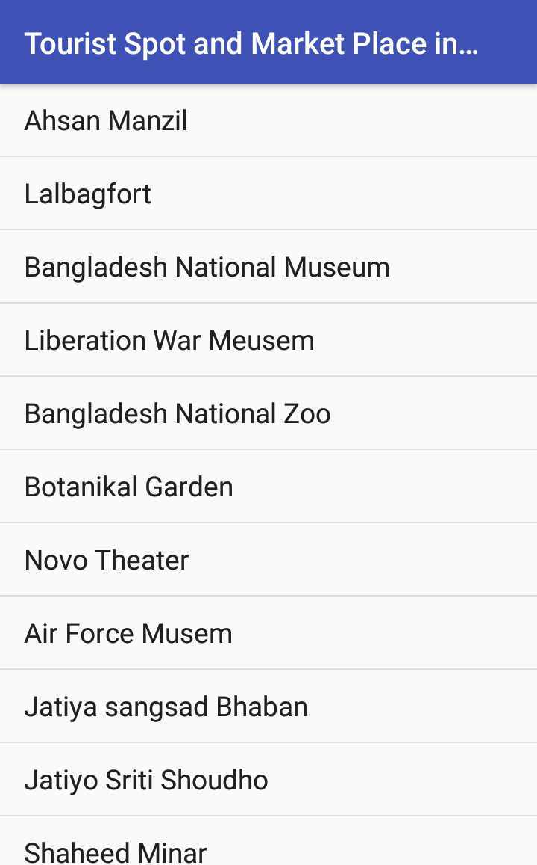
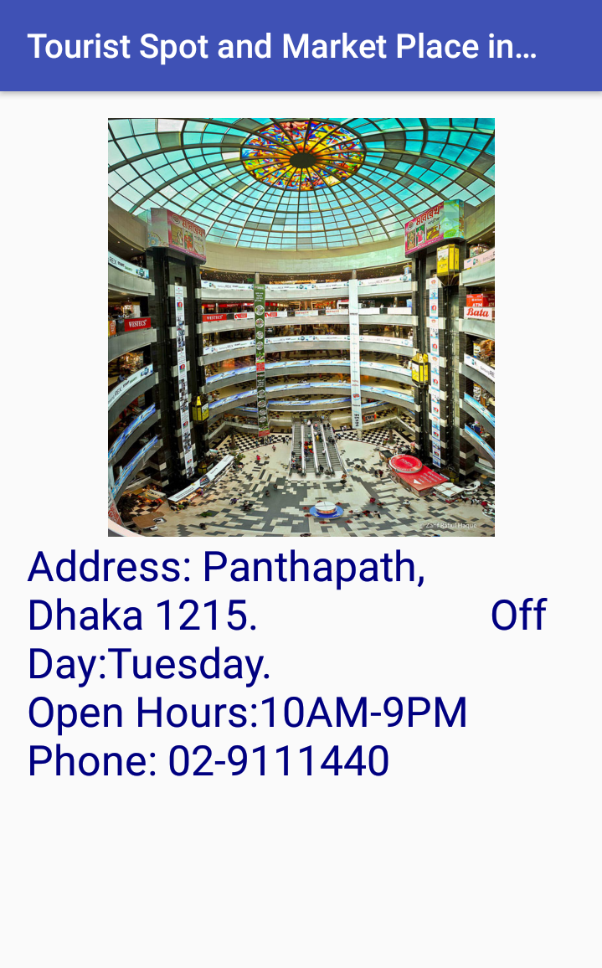
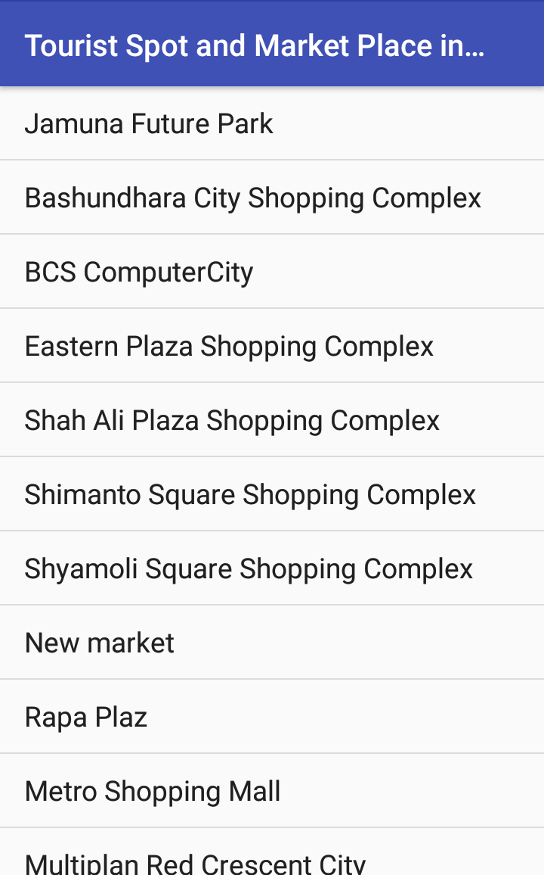
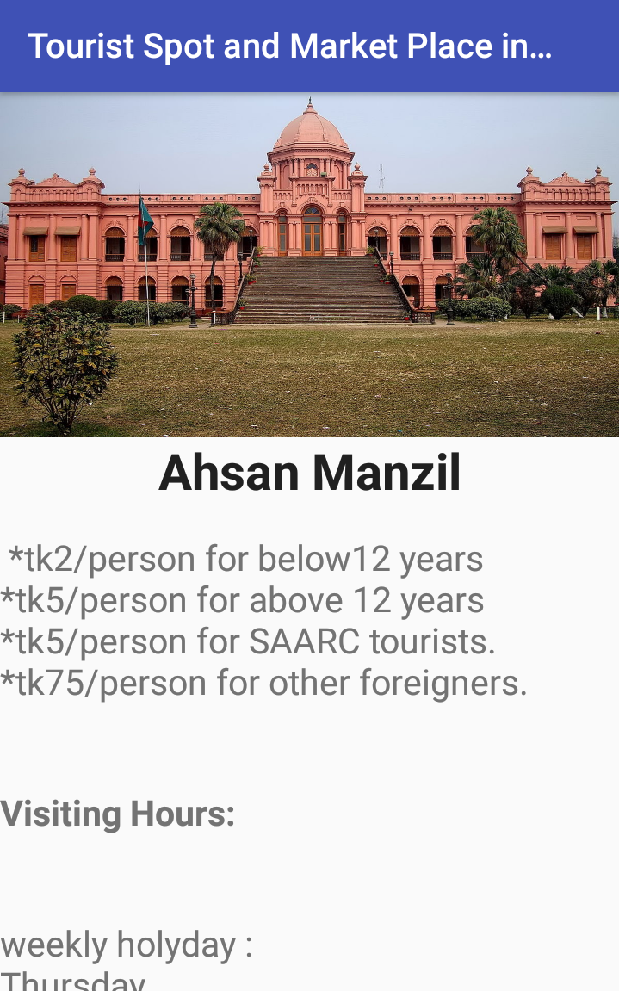
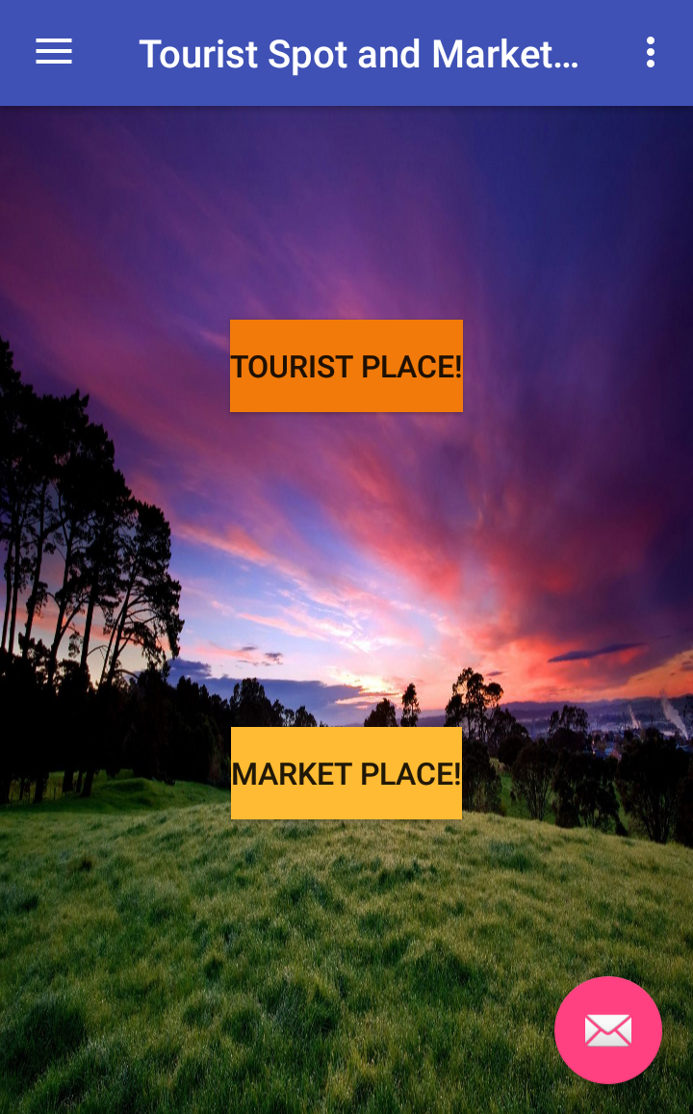
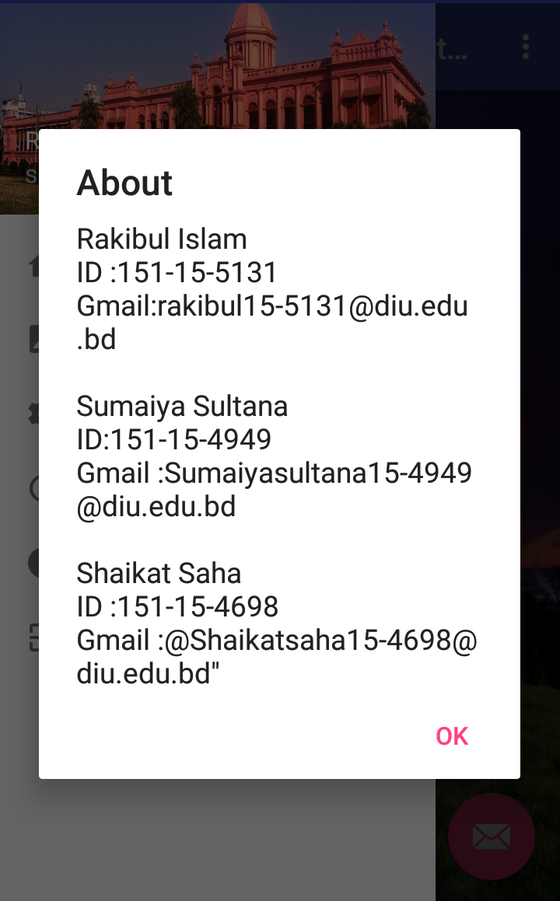
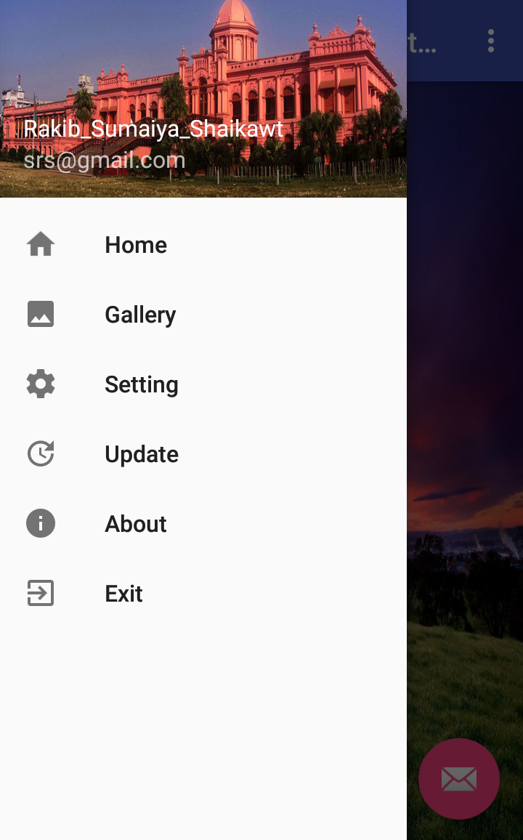
Screenshot

Slide 7
Tools
Android Studio
Google
Android phone

Slide 8
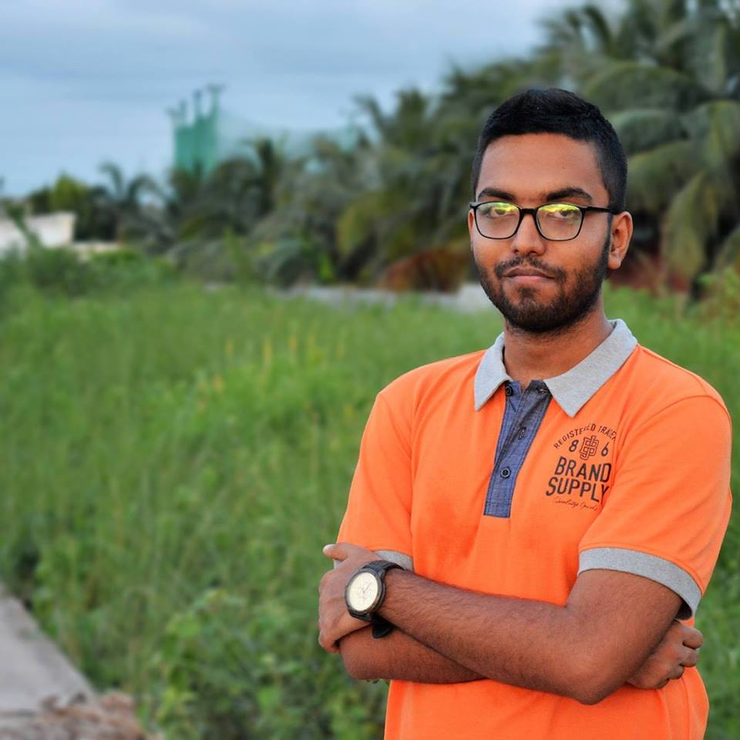
Shaikat Saha
ID:151-15-4698

Slide 9

